Slide 1


The Nature of Leadership
What does leadership mean?
  A process, the use of non-coercive influence to shape the group’s or organization’s goals, and:
    Motivate behavior.
    Define group or organizational culture.
What are the characteristics of those who are perceived to be leaders?

Slide 2
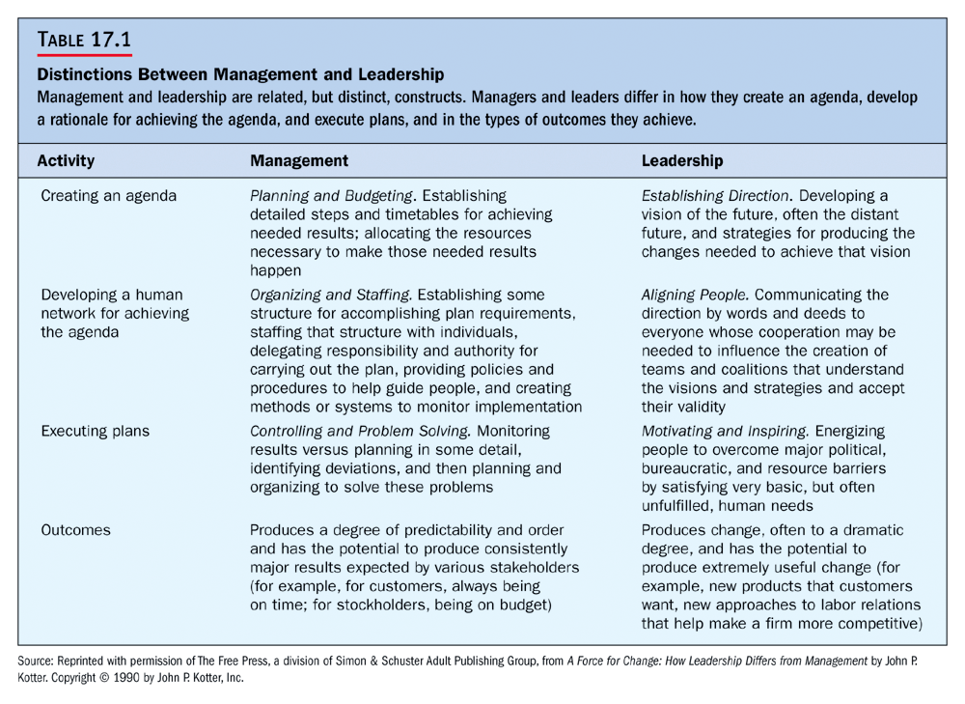

Slide 3
Who Are Leaders?
People who:
  Can influence the behaviors of others.
  Are able to influence without having to rely on force.
  Are accepted by others as leaders.
Leadership Versus Management
MANAGEMENT:
  Planning and budgeting.
  Organizing and staffing.
  Controlling and problem solving.
  Producing a degree of predictability.
LEADERSHIP:
  Establishing direction.
  Aligning people.
  Motivating and inspiring.
  Producing change, often to a dramatic degree.

Slide 4
Power and Leadership
What is power?
  The ability to affect the behavior of others.
Legitimate power:
  Power granted through the organizational structure, it is the power accorded people occupying particular positions as defined by the organization.
Reward power:
  The power to give or withhold rewards, such as:
    Salary increases.
    Bonuses.
    Promotion.
    Recommendation.

Slide 5
Coercive power:
  The power to force compliance by means of psychological, emotional, or physical threat.
Referent power:
  The personal power that accrues to someone based on identification, imitation, loyalty, or charisma.
Expert Power:
The personal power that accrues to someone based on the information or expertise that they possess.

Slide 6
Michigan Studies on Leadership Behavior
Job-centered leader:
  Leaders who pay close attention to an employ’s job and work procedures involved with that job.
Employee-centered leader:
  Leaders who develop cohesive work groups and ensure employee satisfaction.

Slide 7
Ohio State Leadership Studies
Initiating-structure behavior:
  Leaders who define the leader-subordinate roles so that everyone knows what is expected, establish formal lines of communication, and determine how tasks will be performed.
Consideration behavior:
  Leaders who show concern for subordinates and attempt to establish a friendly and supportive climate.

Slide 8
The Leadership Grid
A method of evaluating leadership styles to train managers using OD techniques so that they are simultaneously more concerned for both people and production.
Concern for production:
  Deals with the job aspects of leader behavior.
Concern for people:
  Deals with the people aspects of leader behavior.

Slide 9
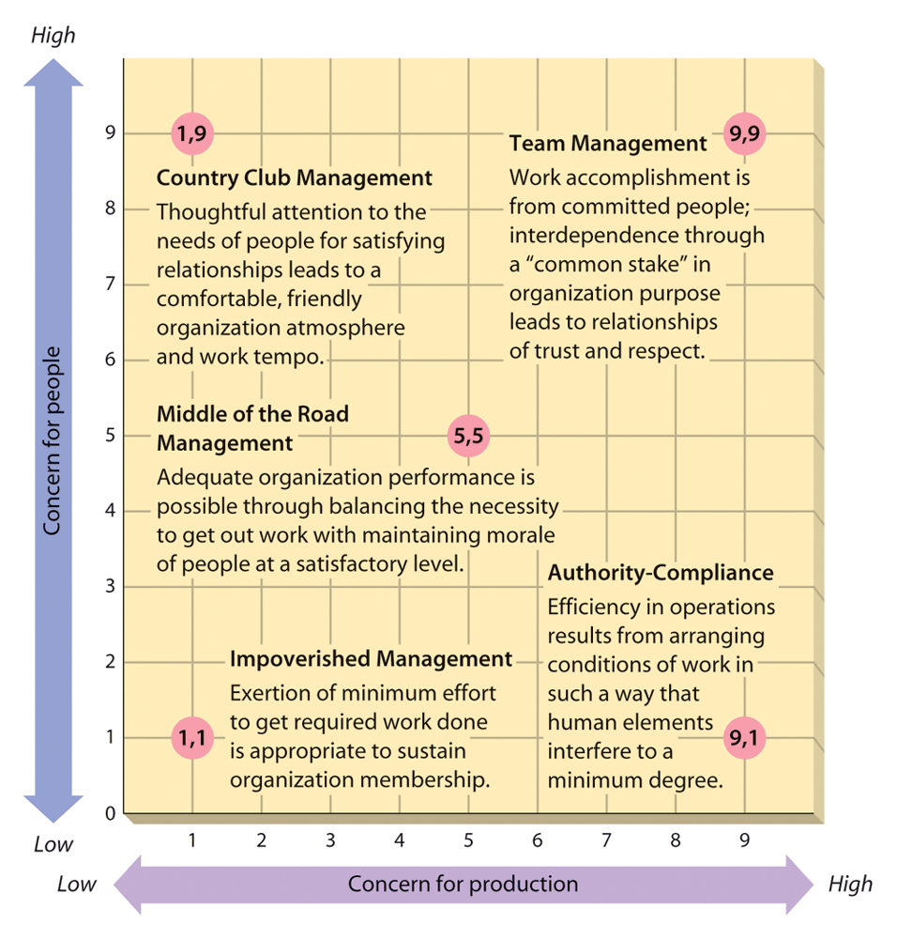

Slide 10
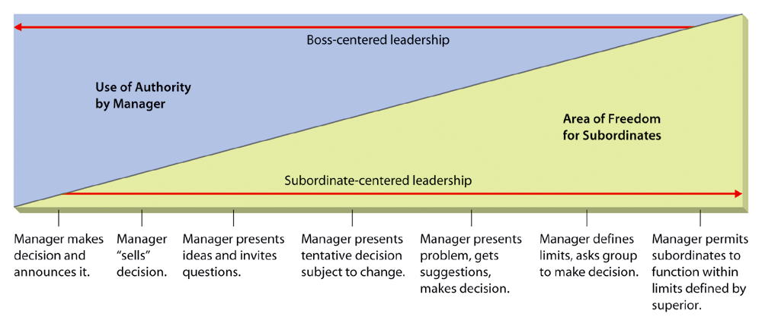
Tannenbaum & Schmidt’s Leadership Continuum

Slide 11
LPC Theory
LPC THEORY:
  Suggests that the appropriate style of leadership varies with situational favorableness.
  Least preferred coworker (LPC):
  The measuring scale that asks leaders to describe the person with whom she/he is able to work least well.

Slide 12
The Path-Goal Theory
A theory of leadership suggesting that the primary functions of a leader are to make valued or desired rewards available in the workplace.
Clarifies for the subordinate the kinds of behavior that will lead to goal accomplishment and valued rewards.

Slide 13
The Path-Goal Framework
Subordinates’
Personal
Characteristics
Perceived ability
Locus of control
Leader Behavior
Directive
Supportive
Participative
Achievement
oriented
Environmental
Characteristics
Task structure
Work group
Subordinates’ motivation to perform

Slide 14
Decision Making Styles
Decide: Manager makes decision.
Consult: (Individually), Present problem to group members individually.
Consult: (Group). Present problem to group members.
Facilitate: Present to group and facilitate group member discussion.
Delegate: Allow group to define parameters, then develop solutions.

Slide 15
The Leader-Member Exchange (LMX) Model
Stresses the importance of variable relationships between supervisors and each of their subordinates.
Leader
Subordinate
1
Subordinate
2
Subordinate
3
Subordinate
4
Subordinate
5
Out-group
In-group

Slide 16
Related Perspectives on Leadership
Substitutes for leadership:
  Identifies situations in which leader behaviors are neutralized or replaced by characteristics of subordinates, the task, and the organization.
Charismatic leadership:
  Assumes that charisma in an individual characteristic of the leader.
Charisma: A form of interpersonal attraction that inspires support and acceptance.
Transformational Leadership
  Leadership that goes beyond ordinary expectations by transmitting a sense of mission, stimulating learning experiences, and inspiring new ways of thinking.

Slide 17
Political Behavior in Organizations
Political behavior:
  Activities carried out for the specific purpose of acquiring, developing, and using power and other resources to obtain one’s preferred outcomes.
Impression management:
  A direct and intentional effort by someone to enhance his/her image in the eyes of others.

